Slide 1
Summer 2017 Internship Project

Slide 2
Project 1
Comparison of Scheduled and Actual Synthetic and Deadhead
Goal : 1. Total Synthetic (E+F+G time) - hours
2. Total Deadhead hours
3. Total Block Time
4. Total number of calendar days
5. Total number of duty periods
6. Total Rest Over Nights (RONs)
Scheduled vs
Actual

Slide 3

Scheduled Query
Table used – Flight_Crew_Emp_Seq_Actl
TTL_RIG_TM – E+F+G Time
TTL_DEDHED_TM –Total Deadhead
TTL_BLOCK_TM – Total Block
SEQ_CALNDR_DAY_CT – Total Calendar days
SEQ_DUTY_PERIOD_CT – Total Duty Periods
FAR 117.5

Slide 4
Actual Query
Main tables used - FLIGHT_CREW_EMP_SEQ_ACT
FLIGHT_CREW_EMP_SEQ
FLIGHT_CREW_EMP_SEQ_ACTL -
ACTL_GATE_TO_GATE_TM - Block Time
SEQ_DUTY_PERIOD_QTY - total no. of Duty Periods
SEQ_DUTY_PERIOD_QTY-1 - RONs
FLIGHT_CREW_EMP_SEQ -
ACTL_SEQ_DUTY_PERIOD_CREDIT_TM - E Time
ACTL_SEQ_CREDIT_TM - F+G time

Slide 5
Actual Query
Other tables used –
FLIGHT_CREW_EMP_CONTRCT_MONTH
FLIGHT_CREW_AIRCFT_EQUIP - 737s
FLIGHT_CREW_EMP_ASGN_FLIGHT - Eliminate Check Airmans
Data verified against Utilization data and FCRM data for –
Captains and First Officers , October 2016 – March 2017

Slide 6
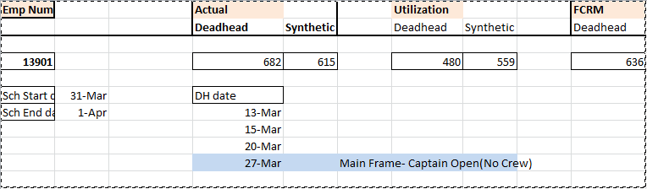
Example

Slide 7
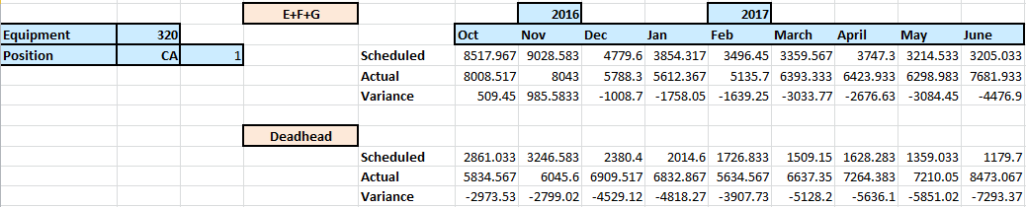
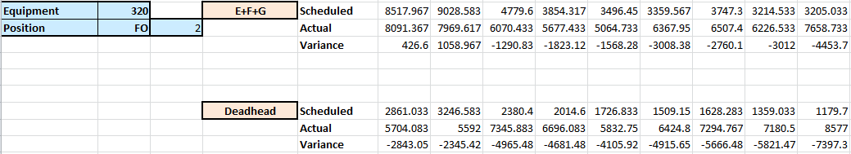
Comparison

Slide 8
Analysis

Slide 9
Project 2
Analysis of Factors Causing Split Trips
Goal:
Identifying the flight leg at which the trip was Split from the originally planned sequence
Getting all information of Planned Sequence as well as Actual Split Sequence in one observation for direct comparison
3. Addition of buffer information (Duty Period buffer, Block buffer) to identify cause of Split

Slide 10
SAS Program
Table : FLIGHT_CREW_EMP_ASGN_FLIGHT
Join
FLIGHT_CREW_PAIRED_FLIGHT
On Seq_Nbr, Flight_Nbr, Schd_Dep_Lcl_Time
Original Planned Sequence Nbr
Where Assigned_Sequence_Nbr >=31000
Join FLIGHT_CREW_PAIRED_FLIGHT
On Seq_nbr, Seq_Schd_Start_date
Join FLIGHT_CREW_EMP_ASGN_FLIGHT
On Flight_Nbr, Schd_Dep_Lcl_Time
Join RELIABILITY_TRAINING_WITH_BUFFER
Original Sequence and Actual Split Sequence Information,
Buffer

Slide 11
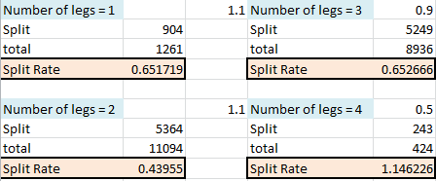
Analysis
Number of legs-
Airport Time -
Airport_time | DFW20 | CLT15 | MIA20
Split Rate | 0.402953 | 0.392727 | 0.371964

Slide 12
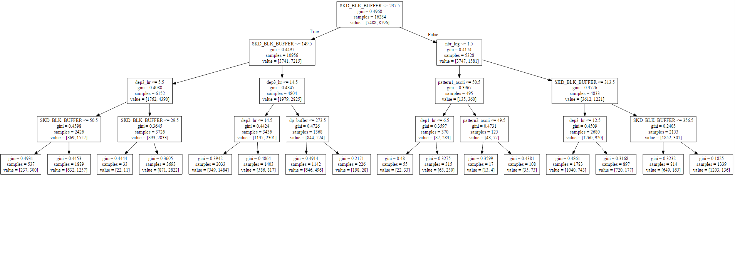
Decision tree
Max Depth of Tree = 4
Training set accuracy: 0.707872758536
Testing set accuracy: 0.701547531319

Slide 13
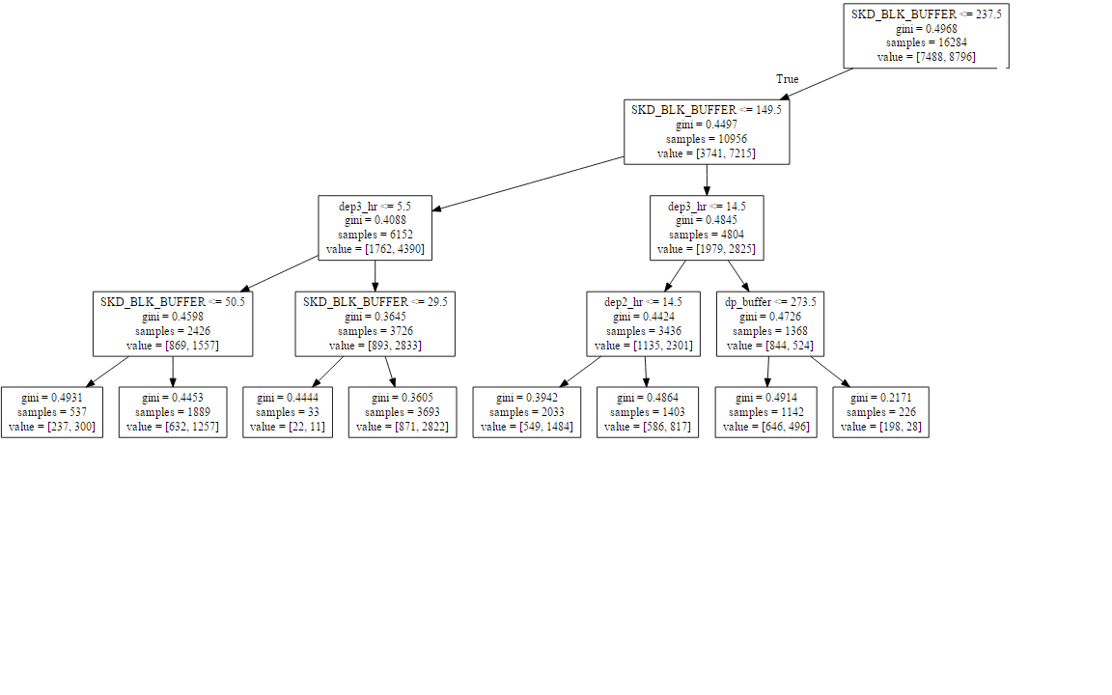
Decision tree

Slide 14
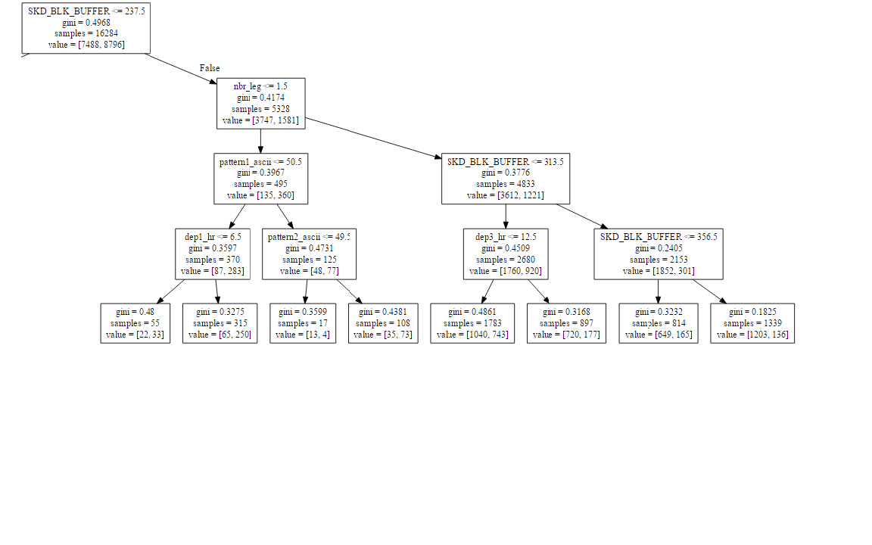
Decision tree

Slide 15
Training Set Validation Example

Slide 16
Thank you

